Slide 1


PMNet In-Network Data Persistence
Korakit Seemakhupt, Sihang Liu, Yasas Senevirathne, Muhammad Shahbaz, Samira Khan
Featured at Open Networking Foundation (ONF) P4 workshop 2022 Published in 2021 ACM/IEEE 48th Annual International Symposium on Computer Architecture (ISCA)
Artifact available at pmnet.persistentmemory.org
Notes:
Hi, I am Korakit Seemakhupt.
I am going to talk about our work PMNet; A system that accelerates update request by persistently storing data in network.
This work has been done in collaboration with Sihang Liu, Yasas Senevirathne, Muhammad Shahbaz and Samira Khan.
This work was published at ISCA last year and will be featured in the upcoming Open network foundation P4 workshop.

Slide 2
Summary
Motivation
Datacenter applications usually store data in separate servers and manage through network
Long latency of accessing data on the server slows down clients
In-network compute reduces read requests’ latency but not update requests
Key Insight
Network devices lack persistent storage and cannot maintain persistent data upon failure
PMNet
Logs requests in network device's persistent memory to move server’s latency off the critical path
Recovers server using logged requests in case of a failure
Integrates in-network data persistence with data replication and caching
Evaluation
End-to-end FPGA implementation of PMNet-enabled NIC and switch
Improves throughput by 4.27x and tail latency by 3.23x over client-server baseline
Notes:
For the summary of this talk, I start with observations that
Data center application usually store data in separate storage servers and manage the data through network
The latency of accessing remote data slows down the client and
In-network compute reduces the latency of stateless read requests but not update requests
Our insight is network devices lack persistent storage and cannot maintain data upon failure
Therefore, we propose PMNet that logs request in PM in the network to move server’s latency off the critical path
and use logged requests in order to recover from failure
We also integrate PMNet with replication and read caching.
For the evaluation, We implement PMNet as a bump in the wire in the switch and NIC and evaluate whole system.
The result shows that PMNet significantly improves update request throughput and tail latency over client-server baseline.
Let get started.

Slide 3
Outline
Background and Motivation
In-network Data Persistence
PMNet Design
Caching and Replication
Evaluation
Conclusion
Notes:
I will start the talk with the Motivation of PMNet.

Slide 4





Storage Applications in Datacenter
Common datacenter applications store data in separate storage servers
Memcached
MariaDB
Redis
Social networking
Online Transaction Processing
Network
Client Applications
Storage Servers
Latency of accessing data on the storage server is critical to the performance of these applications
Notes:
For the motivation of this work,
Common applications in datacenter store data in separate servers.
For example, the front end of the social networking and Online transaction processing such as banking application access storage backend such as Memcached and Redis.
The latency of accessing data in the storage server is critical to the performance these applications.

Slide 5
Storage Applications in Datacenter
Common datacenter applications store data in separate storage servers
Memcached
MariaDB
Redis
Social networking
Online Transaction Processing
70% latency
Network
Client Applications
Storage Servers
Our breakdown shows that 70% of latency is from server side
Notes:
In case of Redis, our breakdown shows that 70% of the latency is from the server side.
Next, we want to see where the latency comes from.

Slide 6

Latency of Accessing a Data Store
Client’s progress
Client
Network
Server
Request
Process
Response
Processing
Network Stack
Network Stack
Processing
Client
Server
Observation: The client stalls waiting for the response from the server
Notes:
When a client sends a request to access the data on the server,
The request is forwarded through network stack of the client, through the network and enters the network stack of the server.
Then the request is processed by the server and the server sends the response to the client during which the client stalls waiting.

Slide 7

Mitigating Server-side latency
Request
Response
Client
In-network compute and cache
Server
In-network compute [Brainwave NPU ISCA’18, iSwitch ISCA’19, E3 ATC’19, iPipe SIGCOMM’19]
Add compute logic to network devices, such as switches and NICs
Reduce RTT of compute tasks
In-network data caching [NetCache SOSP’17, Incbricks SOSP’17, DistCache FAST’19]
Add volatile cache in network devices
Reduce RTT of GET requests
Some read requests can be served faster from the network device. Can we do the same for update requests?
Notes:
To mitigate the server sided latency.
In-network compute adds application logic in network device to reduces the latency of computing tasks.
Another approach is by placing volatile cache in-network to serve the read requests.
In-network cache moves server latency off some read requests’ critical path.
But, Can we apply the same idea for the update request?

Slide 8

In-network Caching: Update Requests
Client’s progress
Client
In-network cache
Server
SET (x, 1)
Request
Failure
SET (x, 1)
Request
Process
ACK
Response
In-network write caching with no persistent storage can cause data loss upon failure
Notes:
For the update request, because failure can happen while the request is being delivered to the server and causes data loss,
the client need to wait until it receives the response from the server because it needs to ensure that the result of an update is persistently stored on the server.
Thus, caching data in network without persistent storage in network device can cause data loss upon failure.

Slide 9
Outline
Background and Motivation
In-network Data Persistence
PMNet Design
Caching and Replication
Evaluation
Conclusion
Notes:
Next I will talk about the Key idea of PMNet which is in-network data persistence.

Slide 10
Our Proposal: In-network Data Persistence
Add Persistent memory to network device
Client
PMNet
Server
Add persistent memory to log update requests
Notes:
To reduce the blocking time of update requests, PMNet adds persistent memory to network devices.
Persistent memory allows network devices to persistently log update requests.

Slide 11
Key Idea: Persistent Logging
1
Log request
Send ACK to unblock the client as soon as the update request persists
Forward the request to the server
2
3
Client’s progress
Client
PMNet
Server
SET (x, 1)
3
Request
Off the critical path
Request
Sub-RTT
Log
RTT
1
ACK
Process
2
Response
Response
PMNet enables sub-RTT data persistence in the network
Notes:
Here is how PMNet’s persistent logging works.
Upon receiving an update request from the client, PMNet logs the request in the persistent memory.
After the request persists , PMNet sends ACK to immediately unblock the client.
At the same time, PMNet forwards the update request to the server, the server then process the request off the critical path.
Therefore, PMNet unblocks the client before the server respond and enables sub-RTT data persistence in the network.

Slide 12
Persistent Logging Challenge
How to recover lost packets?
Request
In-flight requests can be lost due to a crash
Notes:
However, there is a challenge for persistent logging.
how to recover lost requests when failure happens before the server processes the request.

Slide 13
Challenge: System Recovery
Failure
Client’s progress
Client
PMNet
Server
Set (x, 1)
Request
Failure
Request
Log
ACK
Response
The client receives ACK and cannot resend the request
Notes:
For example, after the client sends the update request, PMNet device logs the update request and sends the ACK to the client.
Then a failure happens before the request arrives at the server.
Since, the client is unblocked and has proceeded to the next operation, it cannot resend the request.

Slide 14

Solution: Recover from Persistent Logs
1
Server sends Retrans
PMNet looks up logged update request
PMNet resends logged request to the server
2
Heartbeat
3
Recovery
Client’s progress
Client
PMNet
Server
Retrans
Look up
Resend
Process
PMNet recovers lost requests from persistent logs
Notes:
In order to recover a missing request,
First, the server detects a failure using a timeout or a heartbeat signal.
Then, the server sends Retransmit request to PMNet device.
The PMNet device reads logged update request in PM and resends it to the server.
The server then processes the request normally.
Therefore, PMNet recovers lost requests from persistent logs in PMNet network device.

Slide 15
Outline
Background and Motivation
In-network Data Persistence
PMNet Design
Caching and Replication
Evaluation
Conclusion
Notes:
Next, I will talk about PMNet design. How PMNet enables in-network persistent logging.

Slide 16
PMNet Design Overview
PMNet hardware: Use Match-Action Table (MAT) to control persistent memory
MAT Pipeline
Client
Server
Persistent memory
PMNet
PMNet protocol: Identify PMNet packets and trigger processing
PMNet headers
PMNet packet
Eth
IP
UDP
Type
Session ID
SeqNum
HashAddr
Notes:
For the design, I will talk about two parts:
First, the PMNet hardware pipeline
AND Second, PMNet protocol

Slide 17
PMNet Design Overview
PMNet hardware: Use Match-Action Table (MAT) to control persistent memory
MAT Pipeline
Client
Server
Persistent memory
PMNet
PMNet protocol: Identify PMNet packets and trigger processing
PMNet headers
PMNet packet
Eth
IP
UDP
Type
Session ID
SeqNum
HashAddr
Notes:
I will talk about the hardware first.

Slide 18
Baseline NIC/Switch Architecture
Baseline NIC and switch forward packet with rules in Match-action table (MAT) pipeline
Interface
MAT Pipeline
Interface
Forward
Client
Server
Baseline NIC and switch forwards packet to the destination
Notes:
For the hardware, in traditional programmable switch or NIC, the packets are forwarded to the destination according to rules programmed in the Match-action table or MAT

Slide 19
PMNet NIC/Switch Architecture
PMNet NIC and switch’s MAT pipeline process PMNet packet in addition to other packets
Interface
MAT Pipeline
Interface
Client
Server
Log queues
Store logged requests
Log queue isolates PM’s latency from MAT pipeline
PM
Update logs
PMNet MAT Pipeline controls access to the persistent memory
Notes:
On the other hands, PMNet NIC or switch add
Log queue that buffers requests from the MAT pipeline to the persistent memory and the persistent memory stores the logged request.
Thus, in addition to forwarding incoming packets, PMNet’s MAT pipeline controls access to the persistent memory.

Slide 20
PMNet Design Overview
PMNet hardware: Use Match-Action Table (MAT) to control persistent memory
MAT Pipeline
Client
Server
Persistent memory
PMNet
PMNet protocol: Identify PMNet packets and trigger processing
PMNet headers
PMNet packet
Eth
IP
UDP
Type
Session ID
SeqNum
HashAddr
Notes:
Next I will talk about the protocol

Slide 21
PMNet Design: Protocol
Defines four packet types on top of UDP
PMNet headers
PMNet packet
Eth
IP
UDP
Type
Session ID
SeqNum
HashAddr
Notes:
For PMNet protocol, PMNet is built on top of UDP protocol by reserving specific UDP ports.
PMNet header consists of 4 fields, Type that determines different PMNet packet types , Session ID that is used to separate different PMNet session, Sequence number that is used for request ordering and Hashvalue that is used to index the request.

Slide 22
PMNet Design: Protocol
Defines four packet types on top of UDP
PMNet headers
PMNet packet
Eth
IP
UDP
Type
Session ID
SeqNum
HashAddr
Update
Log+forward request, send ACK
ACK
Remove log and unblock client
Types of packet
Retrans
Resend logged entry
Bypass
Forward request
PMNet performs different operation based on packet type
Notes:
PMNet device performs different operation based on type field the defines the packet type.
We will see how PMNet handles each type of packet.

Slide 23
PMNet packet processing: Update requests
1
Log update request
Send ACK to client
Forward request to the server
2
3
3
Forward request to the server
Requests
Forward
Interface
MAT Pipeline
Interface
Request
Client
ACK
ACK
2
Send ACK
Server
Update
Log queues
Log
ACK
Types of packet
1
Log request
Retrans
PM
Update logs
Bypass
PMNet logs and forwards update requests and sends ACK to unblock client
Notes:
For the update request, PMNet first logs the update request in the persistent memory.
After the request persists, PMNet sends ACK to unblock the client.
And at the same time, PMNet forwards the request to the server.
Therefore, PMNet logs and forwards update requests, and PMNet sends ACK to unblock the client once the request persists.

Slide 24
PMNet packet processing: ACK
1
Remove logged request
Forward ACK to the client
2
2
Forward ACK to the client
Interface
MAT Pipeline
Interface
ACK
Forward
ACK
Client
Server
Update
Log queues
Remove
ACK
Types of packet
1
Remove log
Retrans
PM
Update logs
Bypass
PMNet ACK removes the logged entry
Notes:
For the ACK packet which indicates that the server has processed the request, PMNet removes an associated log entry in PM.
AND PMNet forwards ACK to the client.

Slide 25
PMNet packet processing: Retrans
1
Look up logged request
Read logged request
Resend request to the server
2
3
3
Resend the request to the server
Interface
MAT Pipeline
Interface
Retrans
Resend
Request
Client
Server
Update
Log queues
Look up
Read
2
ACK
Read logged request
Types of packet
1
Look up request
Retrans
PM
Update logs
Bypass
PMNet Retrans resends the logged entry
Notes:
For a retrans request that the server sends when the server is recovering a missing packet, PMNet looks up logged request, read logged request and resend the request to the server.

Slide 26
PMNet packet processing: Bypass
1
Forward the request
1
Forward the request to the server
Interface
MAT Pipeline
Interface
Bypass
Forward
Bypass
Client
Server
Update
Log queues
ACK
Types of packet
Retrans
PM
Update logs
Bypass
PMNet forwards Bypass packets
Notes:
For bypass request which the application sends when it wants apply update directly to the server such as synchronization primitives, PMNet forwards the request directly to the server.

Slide 27
Outline
Background and Motivation
In-network Data Persistence
PMNet Design
Caching and Replication
Evaluation
Conclusion
Notes:
Next, I will talk about PMNet’s integration of read caching and replication.

Slide 28
PMNet Use-cases
Client
PMNet
PMNet
Primary
Replica
Replication
Request
Response
Client
PMNet + Cache
Server
Caching
Notes:
Apart form logging update requests to move the server off the critical path,
There are additional applications of PMNet. Those are
Accelerating Replication and serving Read requests with caching.

Slide 29
PMNet Use-cases
Client
PMNet
PMNet
Primary
Replica
Replication
Request
Response
Client
PMNet + Cache
Server
Caching
29
Notes:
First I will talk about replication.

Slide 30
PMNet Replication: Baseline Replication
1
Replicate request to all servers
Process the request
Wait until all servers respond
2
3
Client’s progress
Client
Network
Primary
Replica
Request
1
Replicate
2
Process
Process
2
3
Wait
ACK
Response
Notes:
For replicated server without PMNet, when the primary receives an update request,
it replicates the requests across all replicas.
Only after all replicas finished processing the request, the primary sends a response to the client.
>> next slide

Slide 31
PMNet Replication: Baseline Replication
1
Replicate request to all servers
Process the request
Wait until all servers respond
2
3
Client’s progress
Client
Network
Primary
Replica
Request
1
Replicate
2
No replication
Process
Replication
2
Process
Response
Wait
ACK
3
Response
Replication increases blocking latency
Notes:
We can see that; replication increases the latency of an update request.

Slide 32
PMNet Replication: Replication with PMNet
Two PMNet devices
Two servers
Client’s progress
Client
PMNet #1
PMNet #2
Primary
Replica
Notes:
In order to accelerate replication, PMNet logs update requests in multiple devices to protect against hardware failure.
In this example with two-way replication on the server, the update requests are also logged in two PMNet devices
>> NEXT SLIDE

Slide 33
PMNet Replication: Replication with PMNet
1
The client sends the request and waits for 2 ACKs
PMNet #1 and #2 log the request and send ACK to the client
Client waits until it receives both ACKs
2
3
Client’s progress
Client
PMNet #1
PMNet #2
Primary
Replica
1
Request
Request
Request
Replicate
2
Log
2
Log
Process
ACK
Process
3
ACK
Wait
ACK
Response
Notes:
when the client sends an update request, the request is logged in PMNet devices.
The client waits for two ACKs each sent by different PMNet devices. This ensures that the request persists in both PMNet devices.
Then the request is forwarded to the replicated server, off the critical path.

Slide 34
PMNet Replication: Replication with PMNet
1
The client sends the request and waits for 2 ACKs
PMNet #1 and #2 log the request and send ACK to the client
Client waits until it receives both ACKs
2
3
Client’s progress
Client
PMNet #1
PMNet #2
Primary
Replica
1
Request
Request
Request
Replicate
2
Log
2
+ PMNet
Log
Process
Replication
ACK
Process
3
ACK
Wait
ACK
Response
PMNet exploits persistent logging to move replication off the critical path
Notes:
We can see that, PMNet exploits persistent logging to provide data redundancy and move replication latency on the server off the critical path with small overhead.
Therefore, PMNet exploits persistent logging to persistently replicate data in-network.

Slide 35
PMNet Use-cases
Client
PMNet
PMNet
Primary
Replica
Replication
Request
Response
Client
PMNet + Cache
Server
Caching
35
Notes:
Next, I will talk about caching.

Slide 36
In-network Caching: Update Requests
1
PMNet logs update requests
Client’s progress
Client
PMNet + Cache
Server
SET (x, 1)
Request
Request
Log
1
ACK
Notes:
For the integration of read cache,
first, PMNet logs incoming update request and forwards it to the server.

Slide 37
In-network Caching: Read Requests
1
PMNet logs update requests
PMNet receives read request and looks up an associated logged request in the PM
PMNet responds the read request (Hit) or forward the request (Miss)
2
3
Client’s progress
Client
PMNet + Cache
Server
GET (x)
Request
2
Look up x
x=1
Request
3
Response
3
Cache Miss
Cache Hit
PMNet exploits logged entry and recovery mechanism to respond read requests.
Notes:
Upon receiving the read request, PMNet exploits recovery mechanism to lookup requests in the persistent memory.
If the look up is a hit, PMNet uses logged update request to respond the read request.
Otherwise, PMNet forwards read request to the server.
Thus, PMNet exploits logged update requests and recovery mechanism to accelerate read request.

Slide 38
Outline
Background and Motivation
In-network Data Persistence
PMNet Design
Caching and Replication
Evaluation
Conclusion
Notes:
Next, I will talk about the evaluation

Slide 39
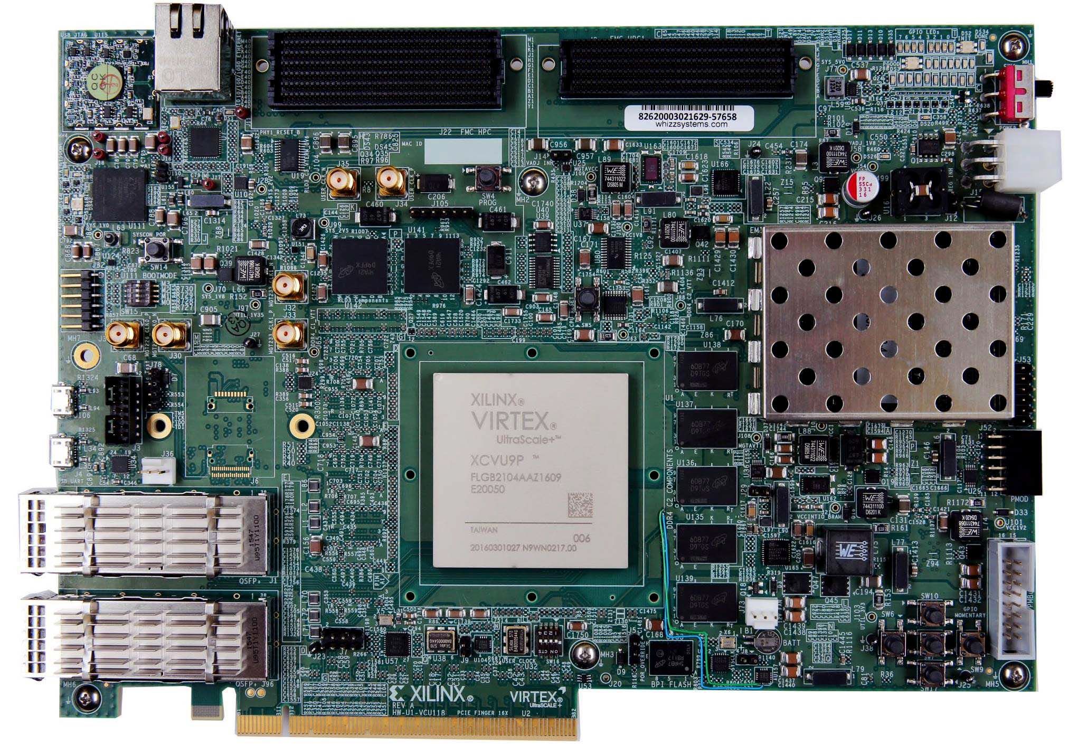
Methodology
Hardware
PMNet
Server
Client
Persistent memory on the server
Xilinx VCU118 Evaluation platform
Intel Cascade Lake, 20 Cores, 192GB DRAM, 256GB DCPMM
Intel Haswell, 6 Cores, 64GB DRAM
1
MAT pipeline (P4)
Emulated persistent memory
Network interfaces
2
2
1
3
3
PMNet evaluation platform
Notes:
For the evaluation,
we implement PMNet on Xilinx’s Virtex Ultrascale + evaluation platform.
We program MAT pipeline in P4 and implement the pipeline on the FPGA.
We use DRAM to emulate the persistent memory and we use QSFP ports as network interfaces.
Note that, our server is equipped with persistent memory to optimize storage performance.

Slide 40
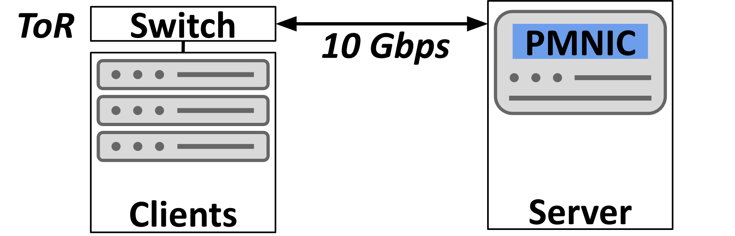
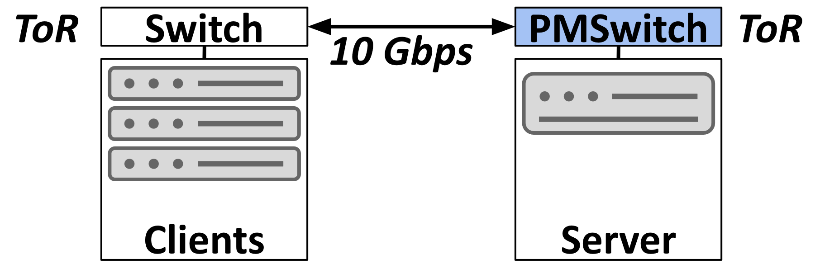
Methodology
Design points
PMNet-Switch: PMNet as a bump-in-the-wire in the TOR switch of server rack
PMNet-NIC: PMNet as a bump-in-the-wire in the server’s NIC
Client-Server: A baseline design that only persists update requests on the server
PMNet-NIC
PMNet-Switch
Notes:
For the design point, we implement PMNet both as a bump-in-the-wire in Server’s NIC and as a bump-in-the-wire in Server rack’s ToR switch and compare them against client-server baseline which only stores data in the server.

Slide 41
Methodology
Workloads
Microbenchmarks: Empty request handler on the server
Persistent-memory-optimized datastore workloads:
PMDK-based database applications: B-tree, C-tree, RB-tree, Hashmap, Skiplist
Redis: TPC-C, Twitter clone
Notes:
For the workloads, we use microbenchmark to test raw performance of our evaluation hardware
And we use persistent memory optimized database workload to evaluate application performance.

Slide 42
Results: Microbenchmarks
Update request Bandwidth vs. Latency
Max bandwidth
Notes:
For the first experiment, we want to see the performance of PMNet device, we use an ideal handler on the server that immediately responds the request.
The figure here shows the Latency-bandwidth of different setups.
The Y axis shows latency and X axis shows the bandwidth.
The red line shows the latency and bandwidth of baseline Client-server setup.
We can see that the client-server baseline achieve maximum bandwidth of around 10 Gbit/s line rate.

Slide 43
Results: Microbenchmarks
Update request Bandwidth vs. Latency
Max bandwidth
Notes:
While Blue line shows latency-bandwidth of PMNet in switch setup.
We can see that, the maximum bandwidth is the similar but with considerably lower latency because the server’s network stack processing is now out of the critical path.

Slide 44
Results: Microbenchmarks
Update request Bandwidth vs. Latency
Same bandwidth
Lower latency
Max bandwidth
Both PMNet-Switch and PMNet-NIC provide lower update latency and
same bandwidth as the baseline.
Notes:
While the dashed line shows PMNet in NIC which has similar performance to PMNet in Switch.
Therefore, by removing the server out of the critical path,
both PMNet in Switch and PMNet in NIC offer the same benefit of lower latency and same bandwidth as the client-server baseline.
We refer to PMNet in switch only as PMNet for later results.

Slide 45
Results: Database workloads
Average Update Latency
4.2X
PMNet effectively reduces the average latency of update requests
Notes:
Next, we evaluate the application performance, this figure shows average update latency of the database workloads. The X axis indicates the workload and Y axis shows the average latency of update requests. We can see that PMNet effectively reduces the update requests latency by moving both server’s network stack and processing out of the update request critical path
especially on the read optimized workload such as Skiplist which has long latency for update operation.

Slide 46
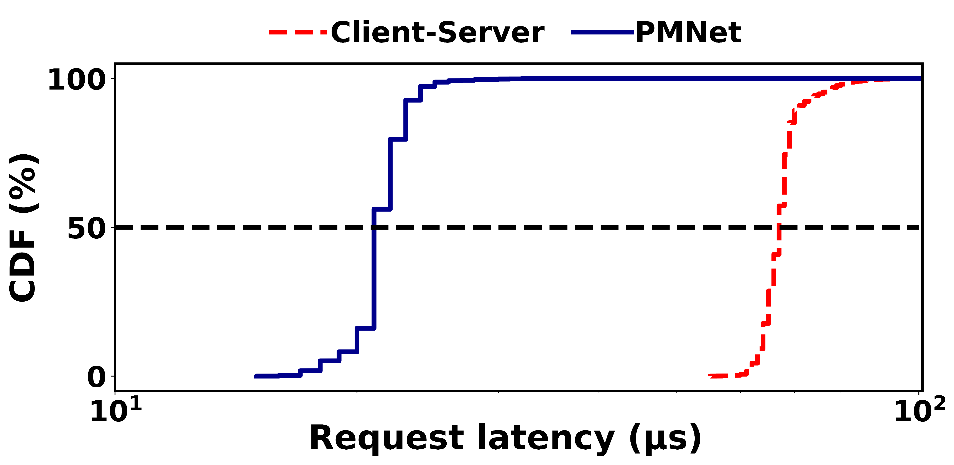
Results: Database workloads
Tail latency (99th-P): 100% Update requests in Redis
Client-server
PMNet
4.5X
10
100
PMNet significantly improves 99-percentile tail-latency of update requests
Notes:
Next, we evaluate the update request’s tail latency of the database application.
This figure shows the latency distribution of the update request in Redis.
X-axis shows the latency of the request. and
Y-axis shows the CDF of the request.
Red line shows the latency of baseline client-server setup and blue line shows the latenct of PMNet setup.
We show Redis workload as an example due to space limitation. Other workloads follow a similar trend.
We can see that for Redis workload, PMNet decreases tail latency of update request by 4.5X.
Therefore, because PMNet persists update requests in hardware with predictable latency, PMNet significantly improves tail lantency of the update requests.

Slide 47
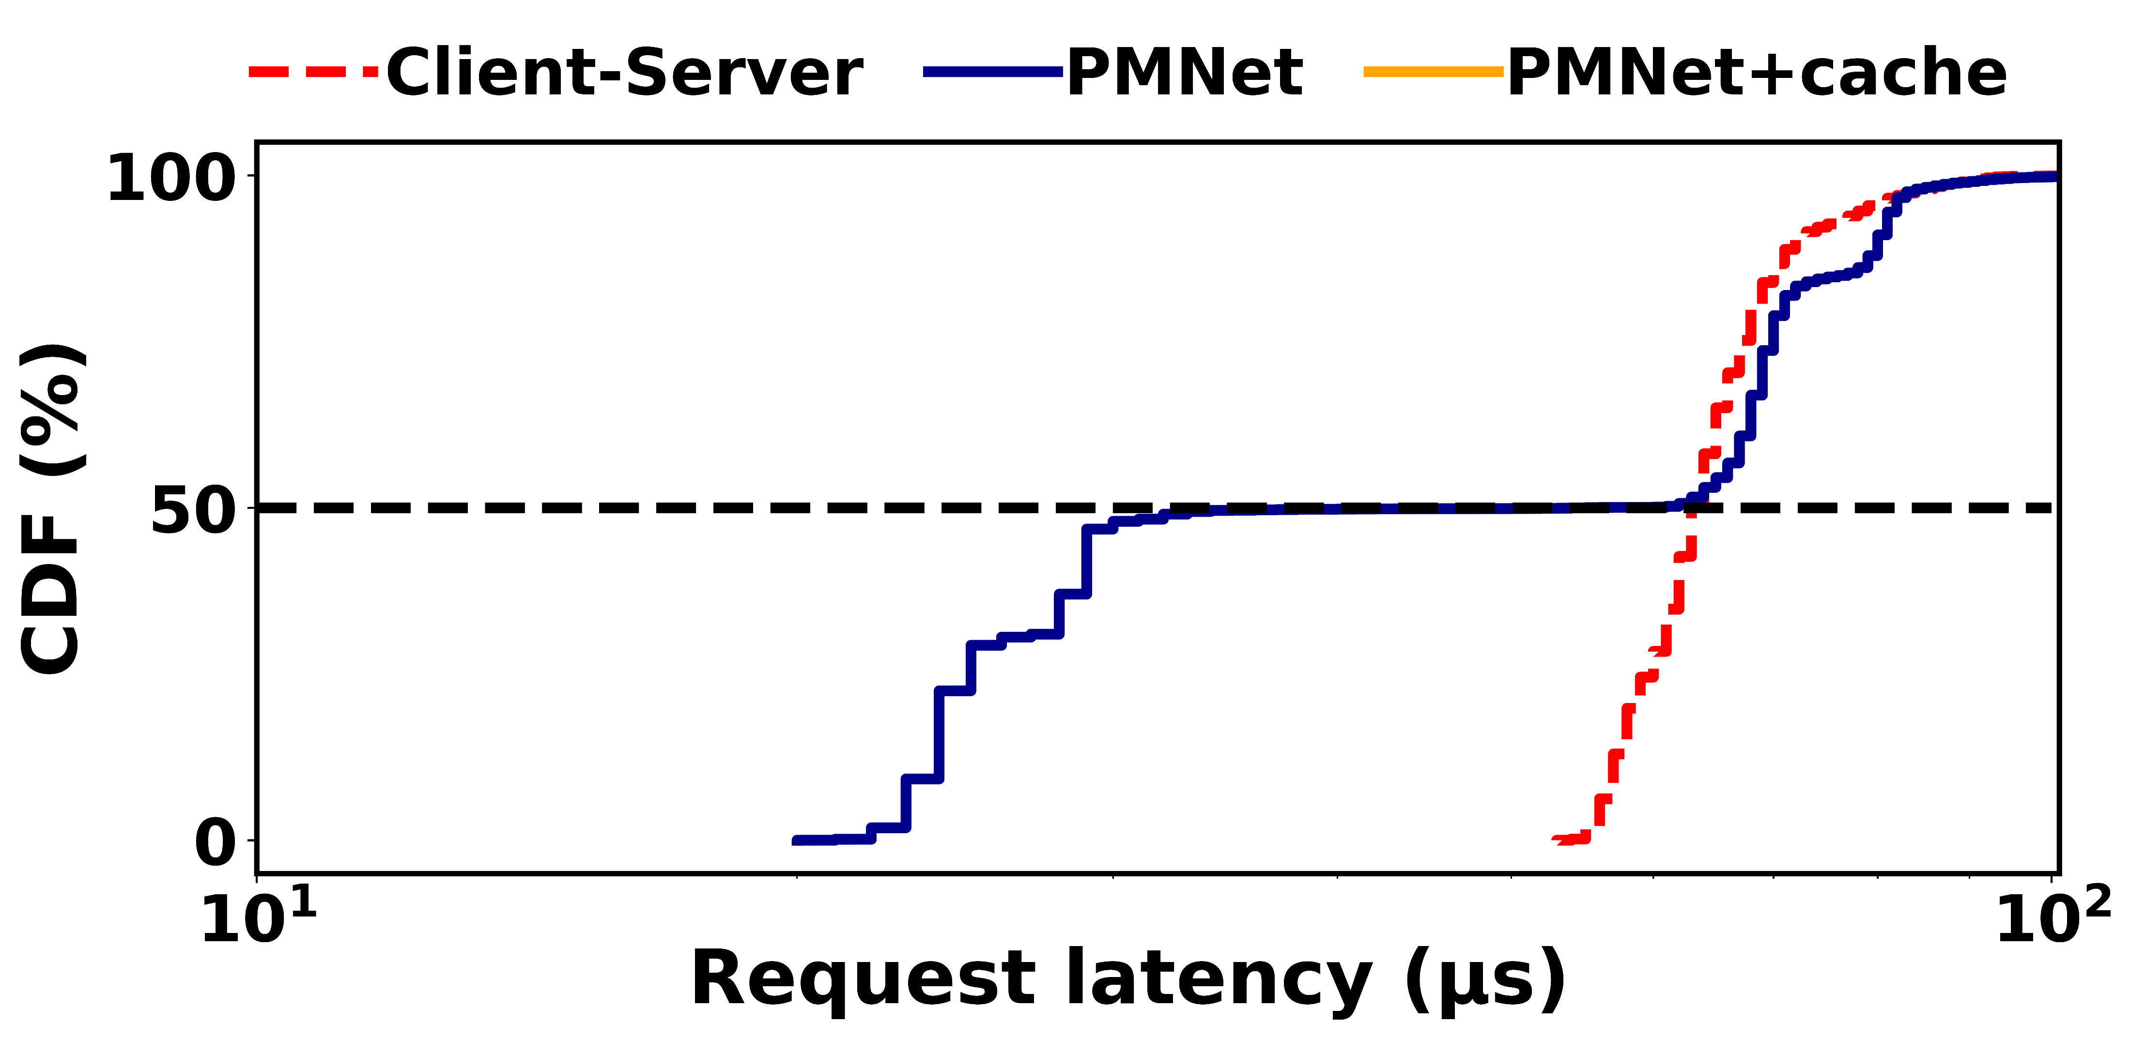
Results: Database workloads
Tail latency: 50%-50% Update-read requests & Cache
Redis
2.5X
10
100
Without read cache, PMNet only improves update requests’ latency.
Notes:
Similarly, we evaluate the performance of mixed read and update requests in 50-50 percent ratio.
We can see that while half of the requests which are update requests are accelerated by PMNet.
Read request performance remain the same.
Thus, PMNet without read caching only improves update performance.

Slide 48
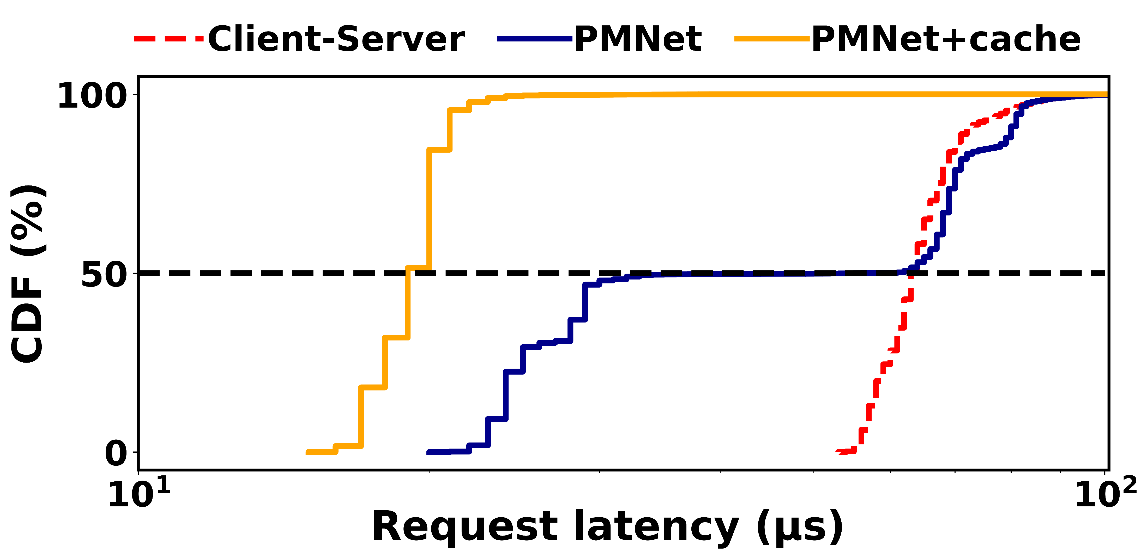
Results: Database workloads
Tail latency: 50%-50% Update-read requests & Cache
Redis
4.3X
10
100
With read cache, PMNet also improves read requests’ latency.
Notes:
On the other hands, with caching shown in a yellow line, PMNet exploits recovery mechanism to respond read request and improves the latency of read requests.

Slide 49
Results: Database workloads
3-way Server Replication (R=3), all workloads average
5.9X
PMNet reduces replication latency while offering the same level of fault tolerance.
Notes:
For replication, we compare the performance of Baseline client-server with and without replication on the server with PMNet with replication both in PMNet devices and on the server and and PMNet without replication.
This graph show the latency of update request on the Y-axis.
The result shows that PMNet with replication reduce the update request latency by 5.9X over client-server with replication. AND the performance penalty of PMNet Replication over PMNet without replication is minor.
Therefore, PMNet moves replication latency off the critical path while maintaining protection against hardware failure.’’
For more details, you can see the full result in the paper.

Slide 50

PMNet
Contributions
PMNet exposes data persistence to the network to accelerate update requests
PMNet integrates replication and read caching
Results
PMNet improves update throughput by 4.2X and tail latency by 3.2X on average
PMNet improves 3-way replication (R=3) latency by 5.9X on average
With Read caching, PMNet improves 50-50% mixed Read-update performance by 3.3X
Update
Off the critical path
Early ACK
Update
Client
PMNet
Server
Featured at Open Networking Foundation (ONF) P4 workshop 2022
Artifact available at pmnet.persistentmemory.org
Notes:
For the conclusion,
PMNet exposes data persistence to the network to accelerate update requests
PMNet can also accelerate replication and read requests.
We also make the implementation of PMNet publicly available in the link here. Thank you.
I am ready to take questions.

Slide 52
Alternative design: Client-sided Logging
1
Request logged in clients’ rack
The client forwards the request to the server off the critical path
The server replicates and processes the request
2
3
On critical path
Network
Requests need to go through client’s network stack
Off critical path
Client
Server
ToR
ToR
2
Request
1
Log
3
Replicate/Process
Client-sided network stack is a bottleneck
Notes:
For logging on the client side, logging a request in single machine can become a single point of failure.
However, logging on multiple machine can be slow because the request needs to go through client’s network stack which is a bottleneck.

Slide 53
Alternative design: Server-sided Logging
1
The client sends the request
The primary server replicates the request to replicas
The replicas log and process the request off the critical path
2
3
On critical path
Network
Off critical path
Client
Server
ToR
ToR
1
Request
2
Replicate
3
Log/Process
Replication latency is still on the critical path
Server-sided logging only moves request processing off the critical path
Notes:
While server-sided logging suffers from the same problem, server sided logging does not move replication latency off the critical path.

Slide 54
PMNet logging
1
The client sends the request
PMNet devices log the request and send ACK to unblock client
The server replicates and processes off the critical path
2
PMNet
3
Log
On critical path
Network
2
Logging in switch is fast
Log
Off critical path
Client
Server
ToR
2
ToR
2
Log
1
Request
3
Replicate/Process
PMNet moves both processing and replication off the critical path
Notes:
On the other hand, PMNet persistent logging in network device is fast and packet is forwarded at line speed.
PMNet effectively moves both processing and replication off update request’s critical path.

Slide 55
Single-client Ordering
Single client ordering
Add SeqNum
SeqNum=2
B
SeqNum=1
A
Request
Request
Client
PMNet
Server
Notes:
To maintain the ordering from the same client, PMNet client adds a sequence number to each PMNet packet.

Slide 56
Single-client Ordering
Single client ordering
Fix order
SeqNum=1
A
SeqNum=2
B
Request
Request
Client
PMNet
Server
The server corrects order based on Sequence Number in each packet
Notes:
The server can then use the sequence number to correct the order and process the request in the same order as sent by the client.

Slide 57

Multi-client Ordering
PMNet bypasses synchronization primitives to ensure single client enters the critical section
Updates in the critical section are still logged in PMNet
Client 1
PMNet
Server
Client 2
1:lock
Time
Client 1
Client 2
1
2
3
4
lock()
tasks()
unlock()
lock()
tasks()
unlock()
2:lock
1:lock acquired
2:lock rejected
Only client 1 can enter the critical section
1:tasks
1:ACK
Bypass requests are infrequent: 13.7% in TPC-C
Notes:
To solve the problem of coordinating multiple clients, synchronization primitives such as lock requests bypass PMNet.
In this case, lock requests is forwarded and processed on the server.
Therefore, only one client acquires the lock and enters the critical section.
Note that even though lock requests cannot benefit from persistent logging, update requests within the critical section can still benefit from shorter latency.
AND, the bypass requests are not frequently used.

Slide 58
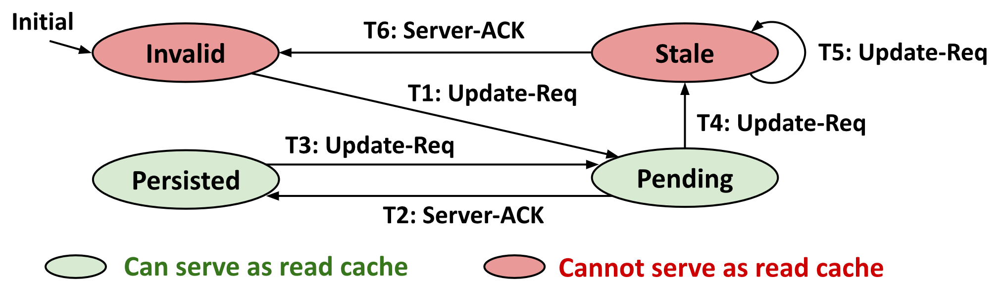
PMNet Caching Protocols
PMNet + caching protocol ensures that
Update requests which have not been processed by the server is not overwritten
Stale requests are not used to respond read requests
PMNet caching protocol ensures both persistence of update request and consistency of read requests’ response.
Notes:
PMNet caching protocols also ensures that both persistence of pending update requests which is not applied at the server and the consistency of read requests are maintained.

